Slide 1

ERAS: Enabling Integration of Real-World Intellectual Properties in Architectural Simulators
The SST and SACA Teams (Sandia, NC State)

Slide 2
Outline
Overview
Motivation
Framework Highlight
Parser
Handlers
Summary
Future Work

Slide 3
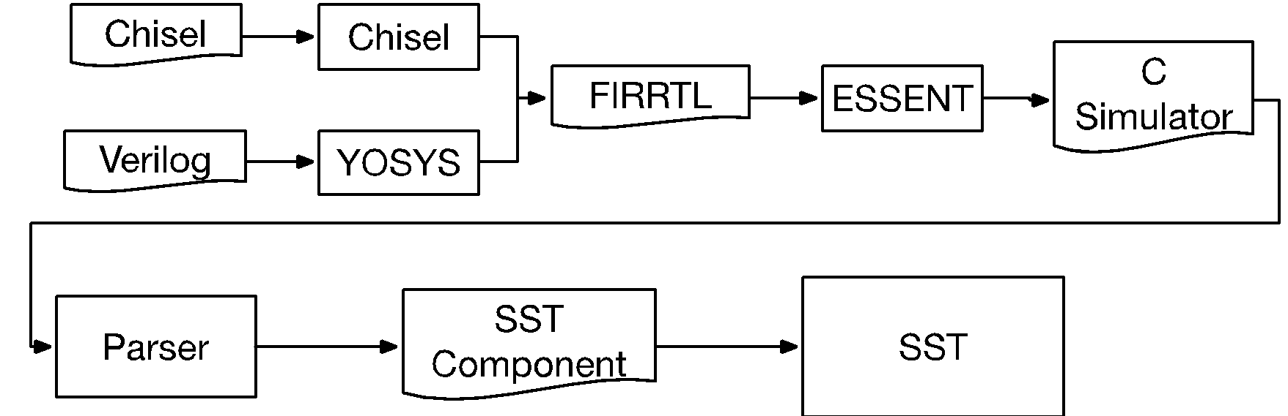

Overview
Frontend HDLs
Tool Flow
Generated C-model
ERAS
Integrable Module
General WorkFlow: HDL → FIRRTL → ESSENT → Parser → SST
Goals:
Support several types of Low-level IPs
Easy, customizable workflow

Slide 4
Outline
Overview
Motivation
Framework Highlight
Parser
Handlers
Summary
Future Work

Slide 5
Why ERAS ?
Analyze impact on system level behavior with realistic cycle-accurate low level IP model
Analyze impact of system level changes on external IP integrated with SST
Extensibility to an extent that full system is modelled through only realistic IPs

Slide 6
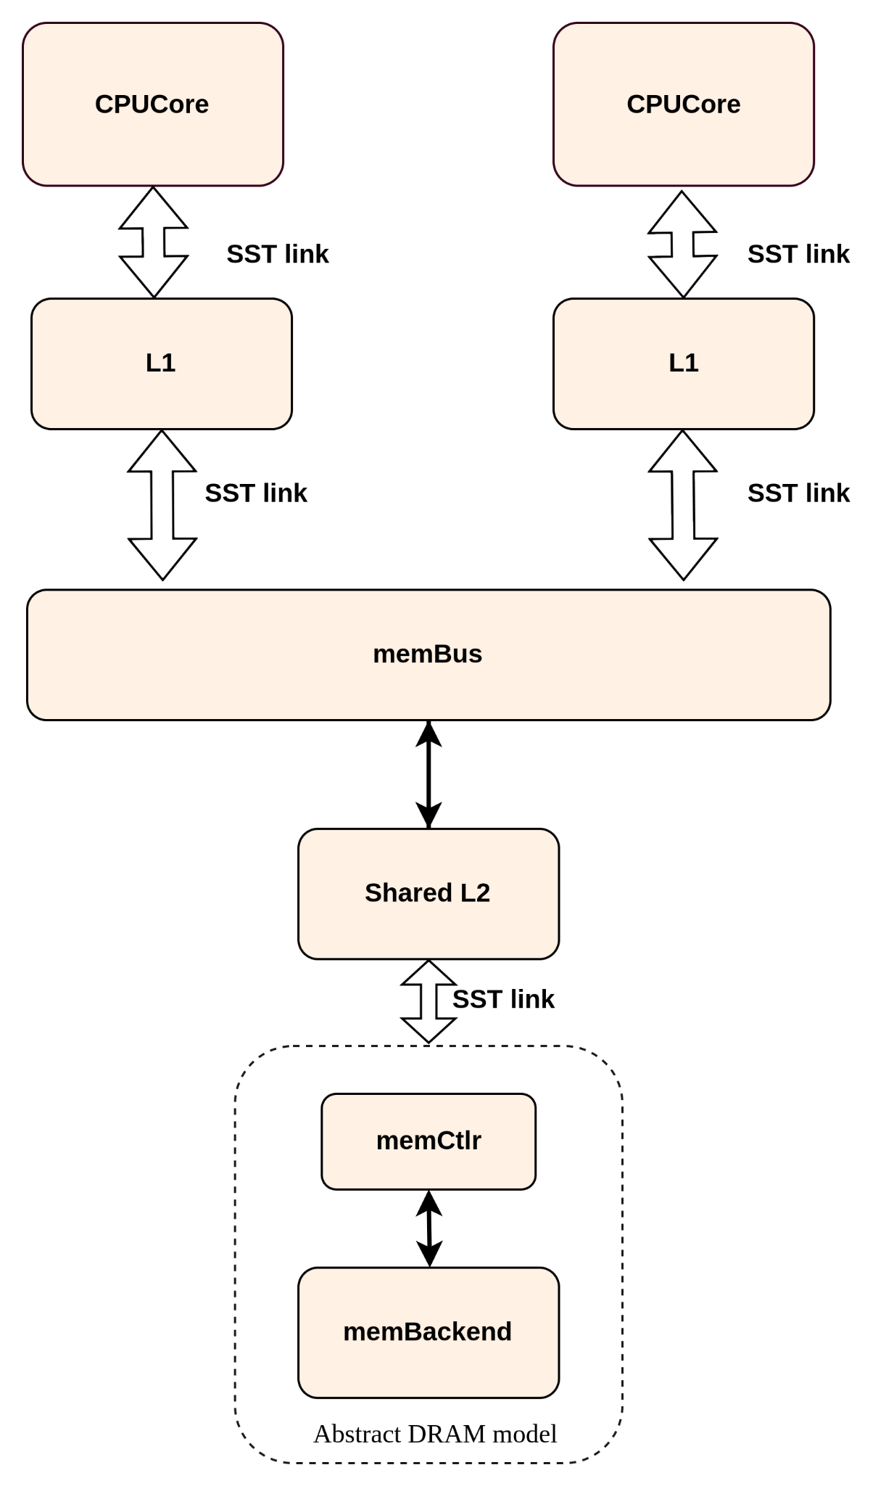
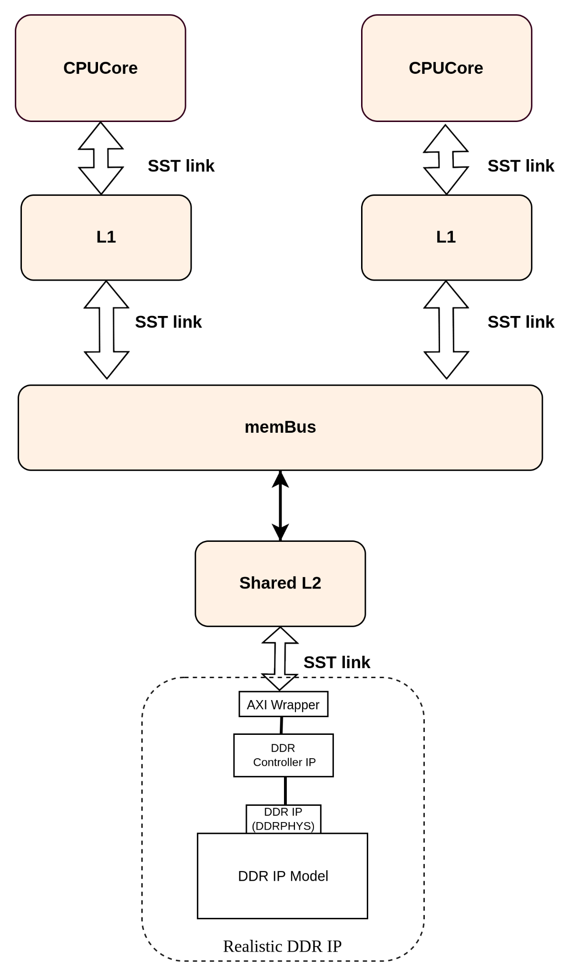
Why ERAS ?

Slide 7
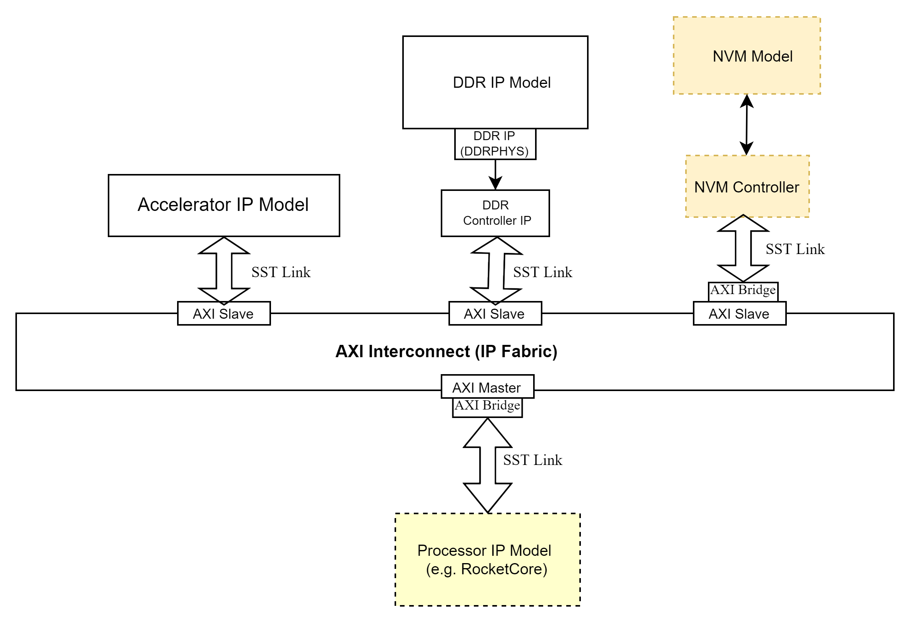
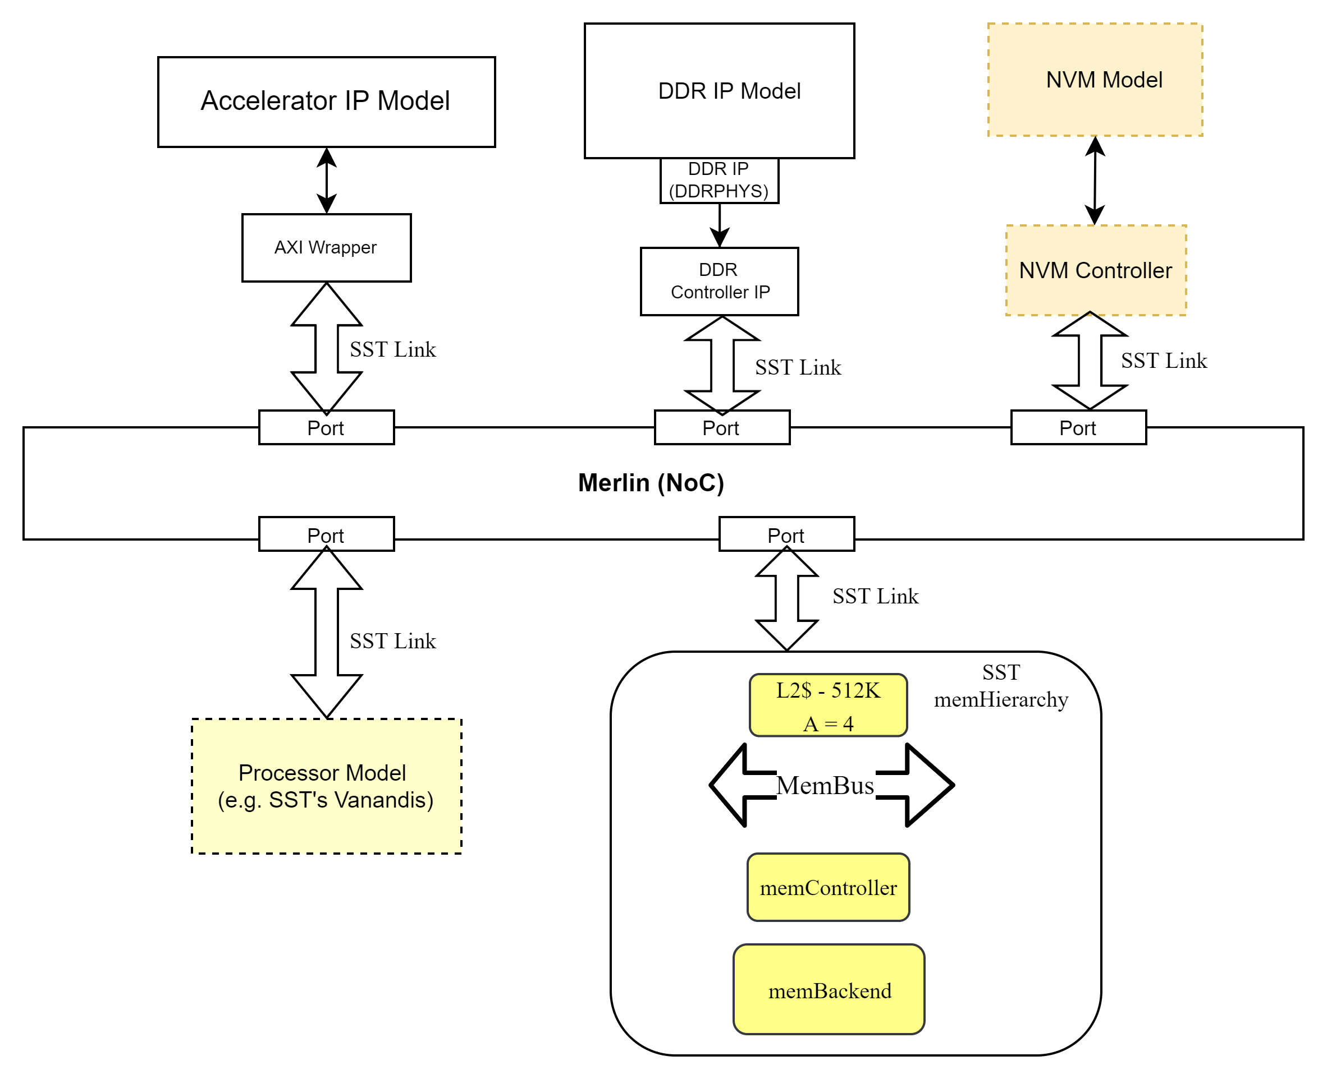
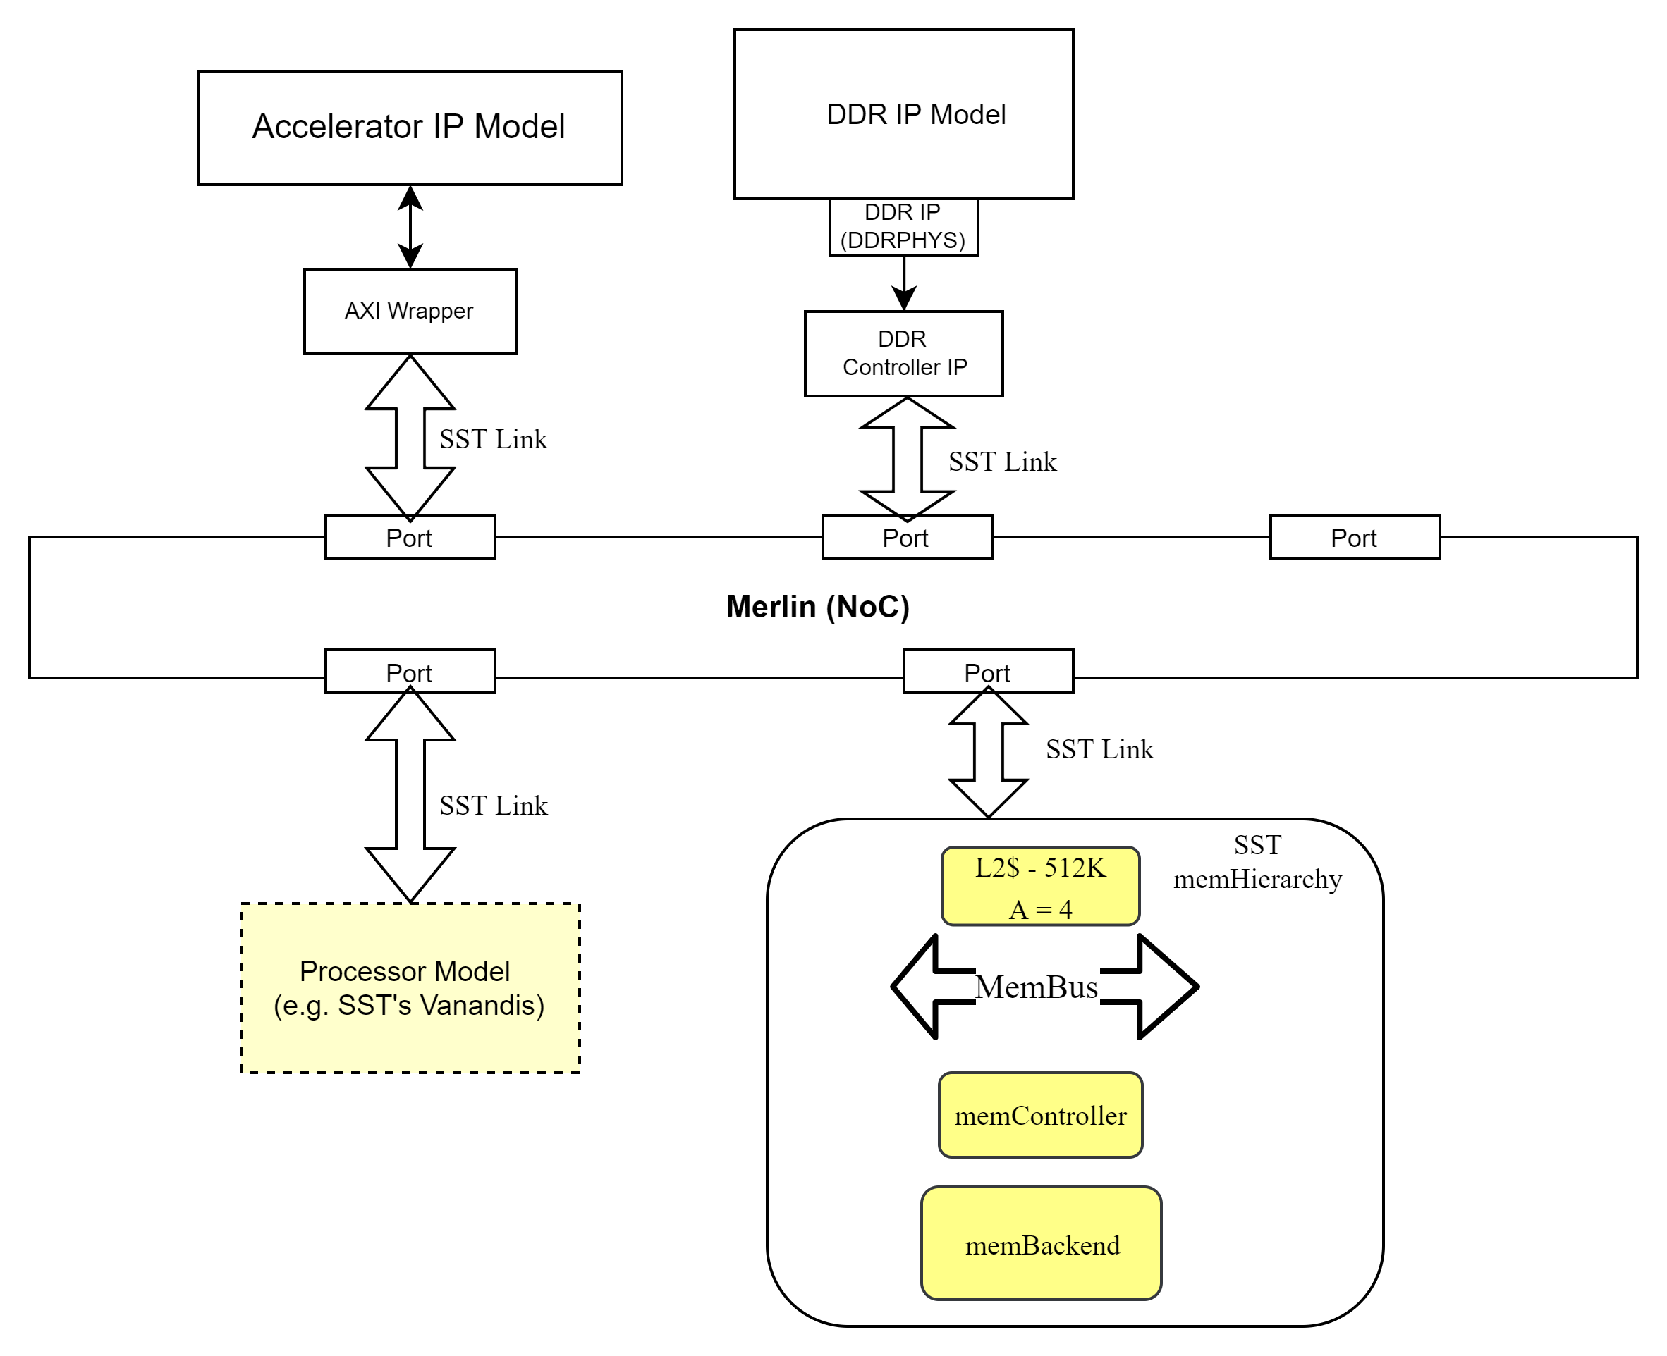

Why ERAS ?
Impact on External IP

Slide 8
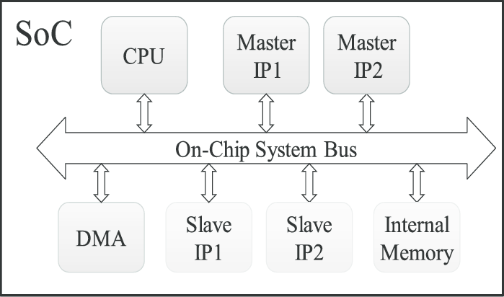
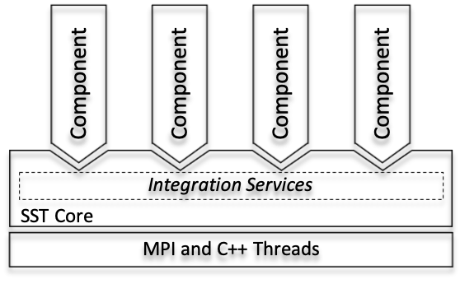
Why ERAS ?
Analyze impact on system level behavior with realistic cycle-accurate low level IP model
Analyze impact of system level changes on external IP integrated with SST
Extensibility to an extent that full system is modelled through only realistic IPs
SST
Component
SST
Component
SST
Component
RTL Model
SST Component
SST
Component
SST
Component
SST
Component
SST
Component

Slide 9
Outline
Overview
Motivation
Framework Highlight
Parser
Handlers
Summary
Future Work

Slide 10
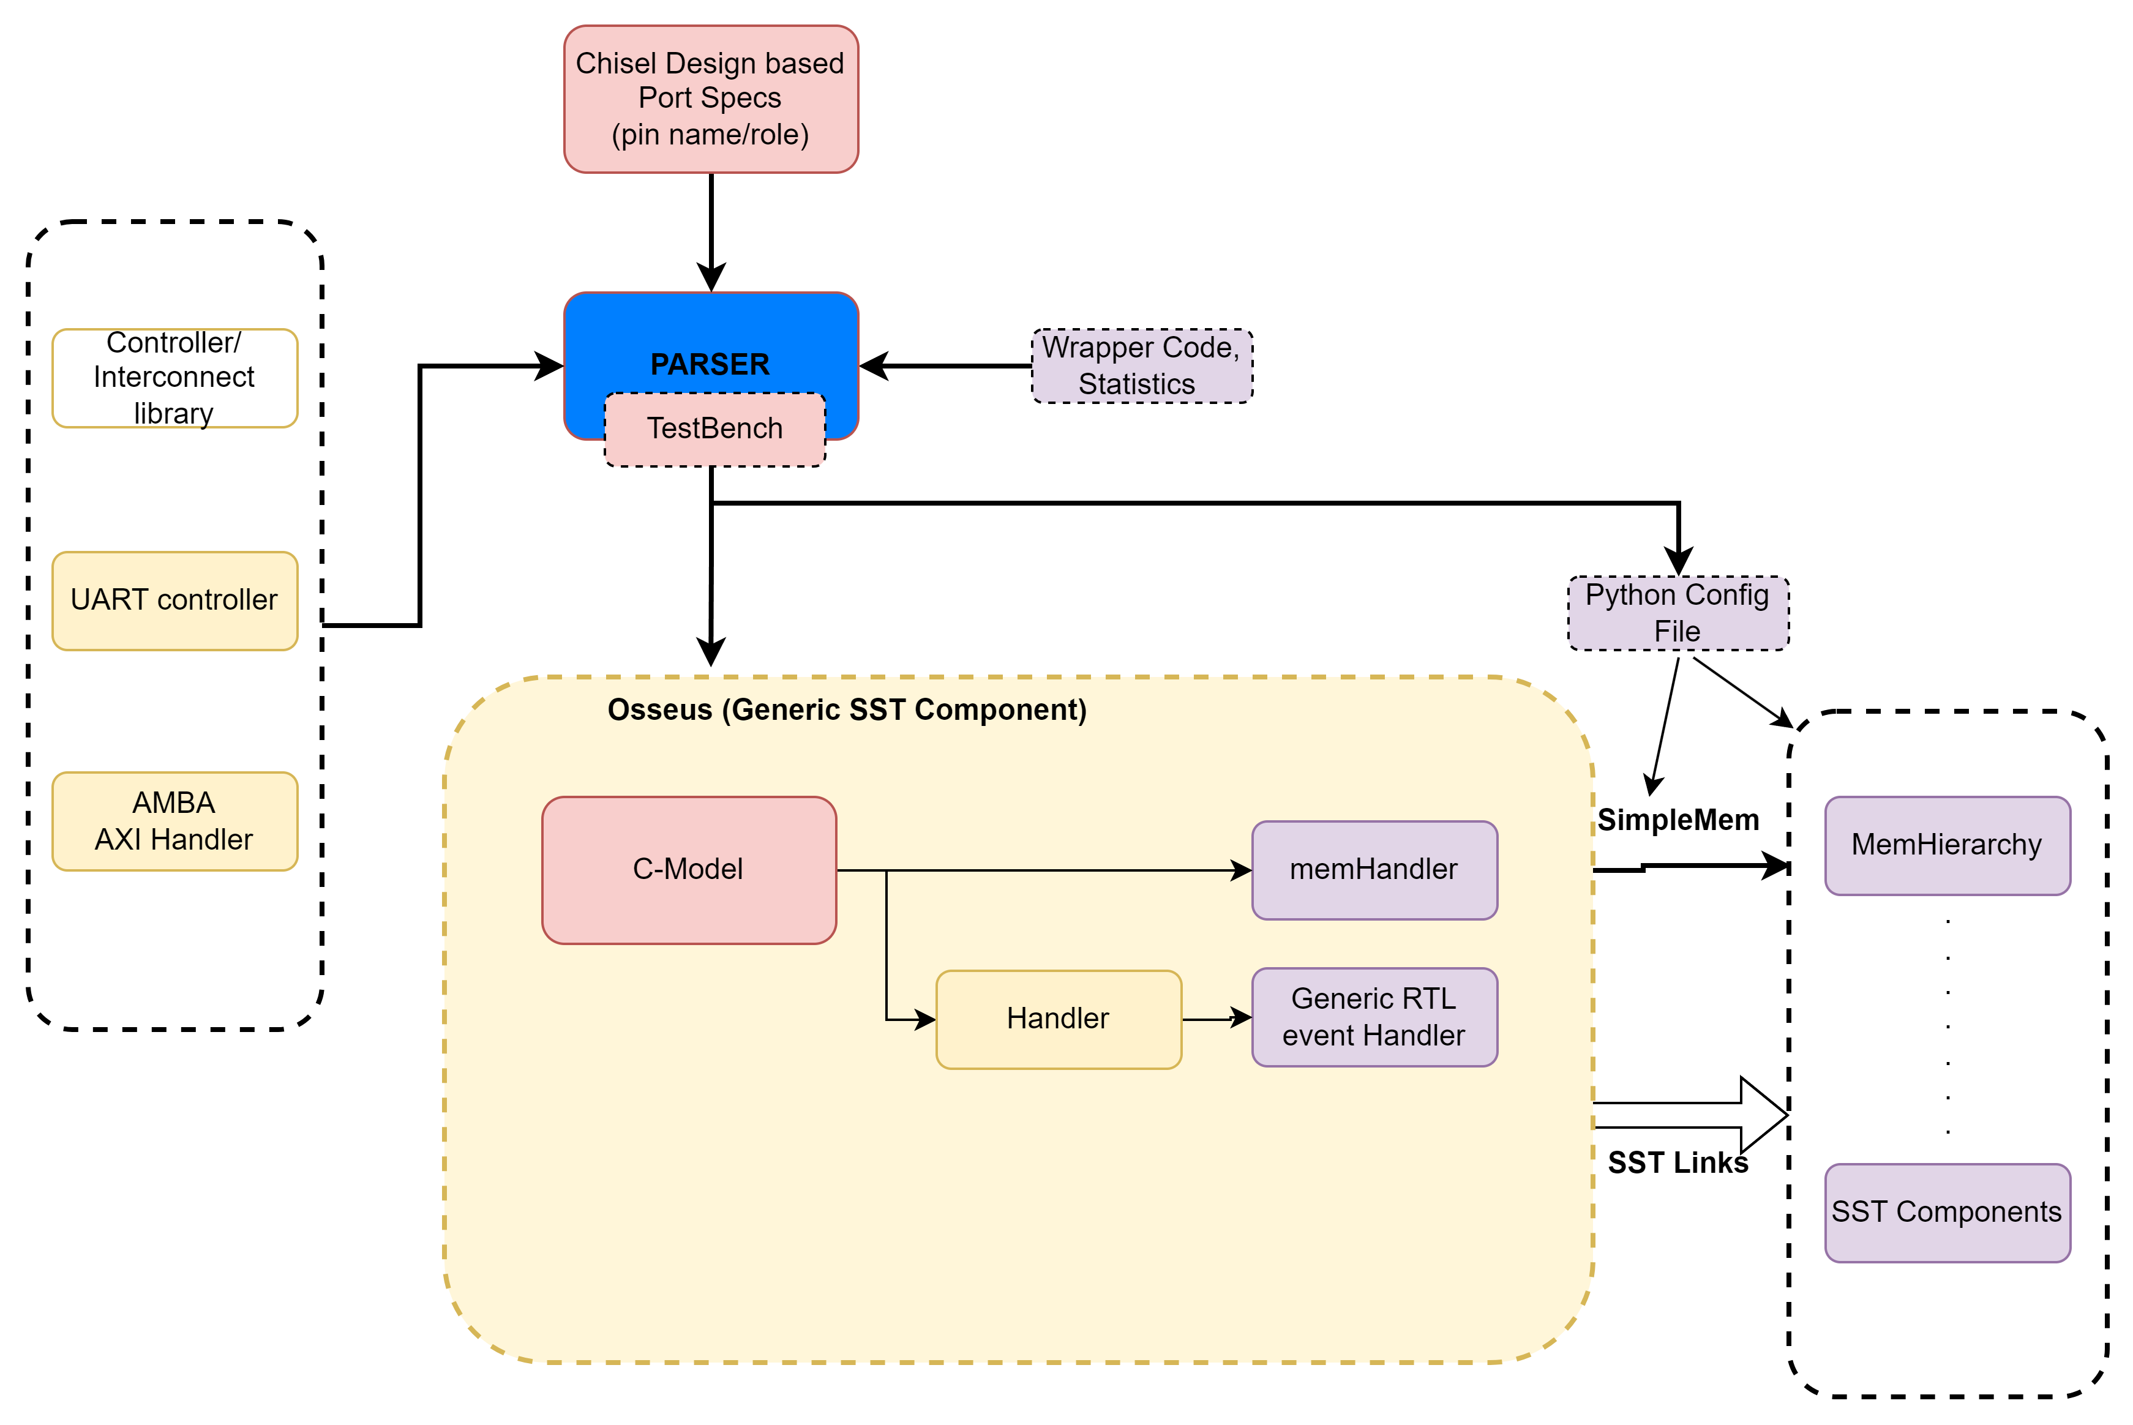
Framework Highlight
Designer provides necessary information to the Parser
Parser interprets the information and invoke necessary blocks of the generic component, referred as Osseus, to integrate the C-model with SST
ISPASS 2023 Tutorial

Slide 11
Outline
Overview
Motivation
Framework Highlight
Parser
Handlers
Summary
Future Work

Slide 12
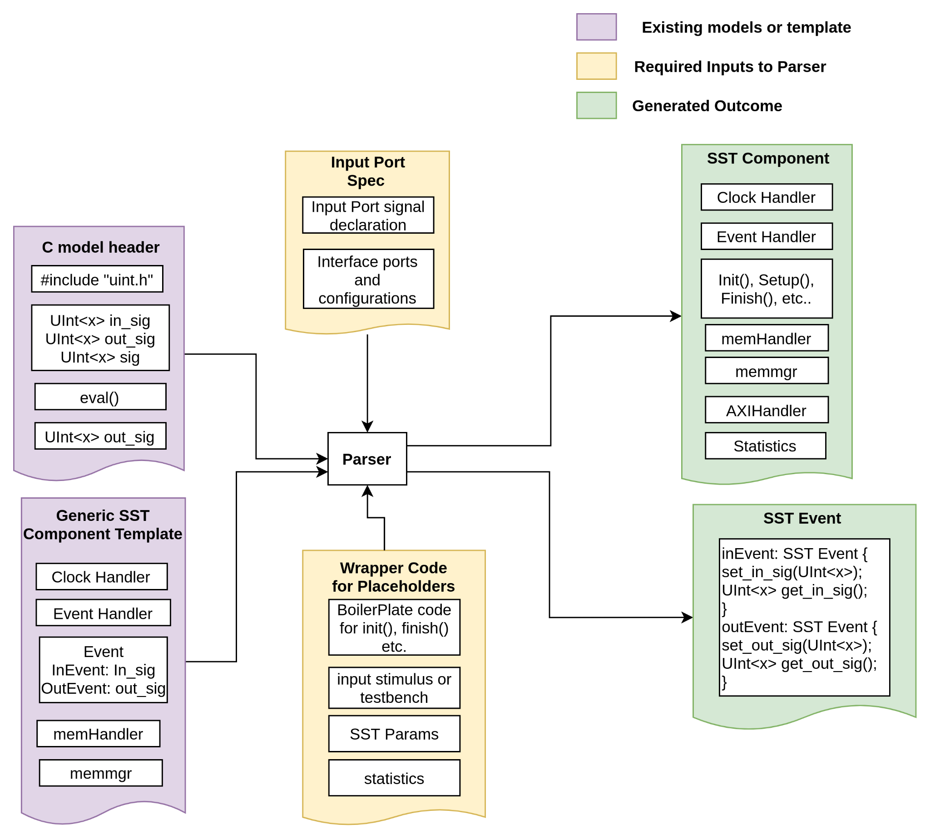
Parser Input Requirements
Osseous APIs (Input Port spec and wrapper code spec)
Clock Handlers – Calls eval() that is clocked each cycle
memHandler – APIs generating & serving mem requests
Memory manager – Address translations
Event Handlers (e.g., interface handlers of AXI)
Element information (SST_ELI_*)
SST Parameters, Statistics, additional ports, slots
Describe parameters from Python Config file
Boilerplate code (init(), setup(), finish() APIs)
Initialize or load test vector/binary files
Creating testbench consumed as x86 binary
ISPASS 2023 Tutorial

Slide 13
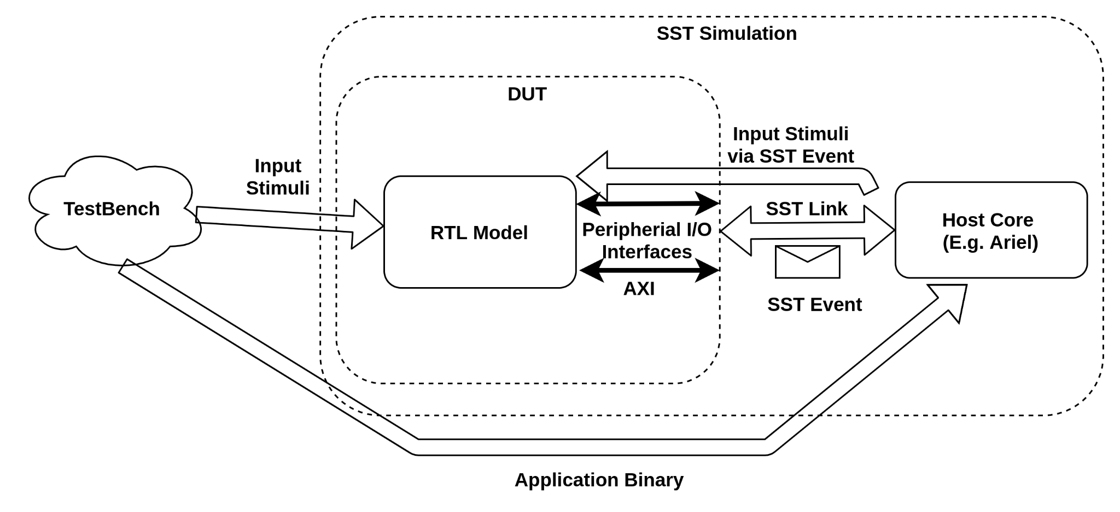
Input Stimulus
Testbench/x86 binary or mem loadable Hex file
RTL Simulation requires input stimulus
TestBench to update RTL signals are written in C and compiled using gcc / g++
Custom APIs to offload computation to RTL model are created (e.g. start_RTL_sim(), update_RTL_sig())
Independent RTL requires loading Hex file to memHierarchy (e.g. RISC-V CPU)
ISPASS 2023 Tutorial

Slide 14
Outline
Overview
Motivation
Framework Highlight
Parser
Handlers
Summary
Future Work

Slide 15
Handlers
Establish Link between SST world and C-model supported interfaces/ interconnect for inter-component communication
Autogenerated code invoked by the parser on demand
Handler records transaction statistics to evaluate performance impacts
ISPASS 2023 Tutorial

Slide 16
Outline
Overview
Motivation
Framework Highlight
Parser
Handlers
Summary
Future Work

Slide 17

Summary
Quick and seamless integration of low-level detailed simulation with highly modular, parallelizable architectural simulator such as SST facilitate:
Fast evaluation of performance impact of designed IP on abstract high level architecture models
System level study of detailed simulation to incorporate early design changes.
Design space exploration driven by real world IP constraints
Save significant efforts in modelling architectural components through exploiting reusability of existing models in SST
ISPASS 2023 Tutorial

Slide 18
Outline
Overview
Motivation
Framework Highlight
Parser
Handlers
Summary
Future Work

Slide 19
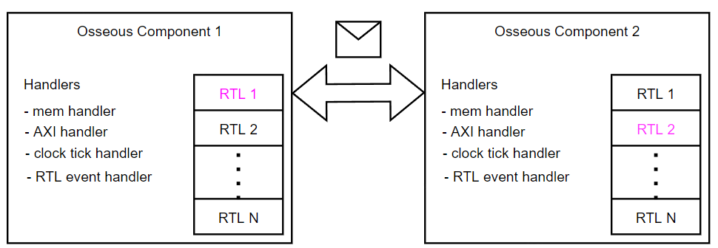
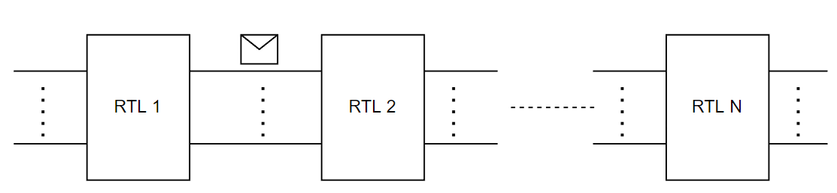
Future Work
Instantiate and interface multiple Osseus components
Take out the dependency on existing SST cores (e.g. Ariel) to run system-level simulation with Osseous
ISPASS 2023 Tutorial

Slide 20
Demo
Example 1: Counter circuit
Workflow and test setup
Verilog vs SST testbench
Example 2: RISCV-Mini
AXI Handler
Design space exploration use case
Summary
ISPASS 2023 Tutorial

Slide 21
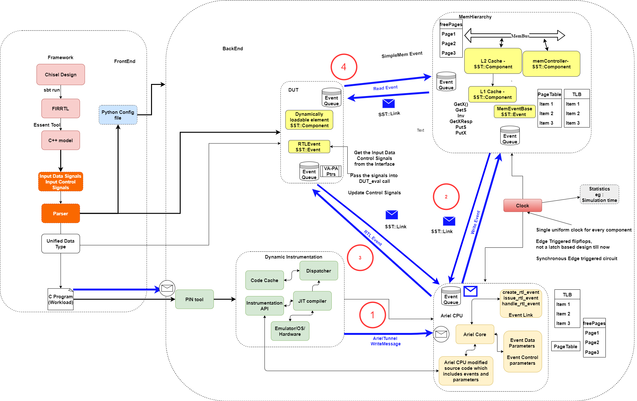
Example 1: Workflow and test setup
The Verilog/Chisel model of the design is translated to FIRRTL which is then used to generate the C-model using Essent¹
The testbench is a C file which is compiled to a x86 binary and executed by Ariel CPU using PIN tool².
The Ariel CPU writes the signal values received from the testbench to the Memhierarchy and notifies the DUT.
The DUT fetches the latest signal values from the Memhierarchy and executes for cycles as determined by the testbench.
1: S. Beamer, "A Case for Accelerating Software RTL Simulation," in IEEE Micro, vol. 40, no. 4, pp. 112-119, 1 July-Aug. 2020, doi: 10.1109/MM.2020.2997639.
2: Pin - A Dynamic Binary Instrumentation Tool (intel.com)
Figure 1: ERAS framework workflow and test setup
ISPASS 2023 Tutorial

Slide 22
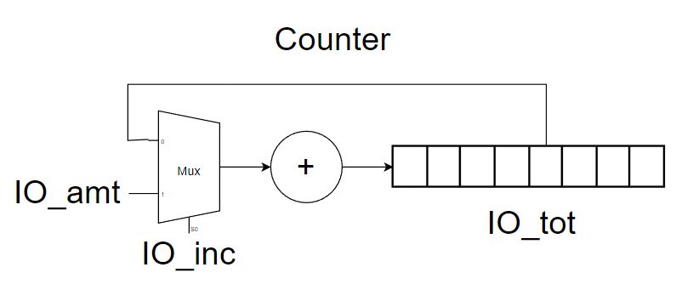
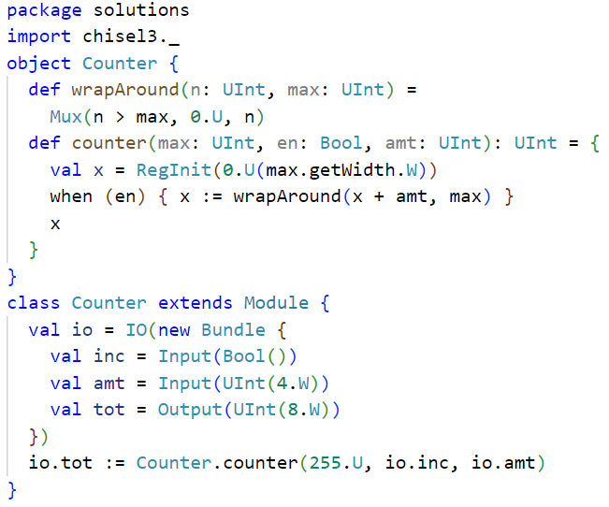
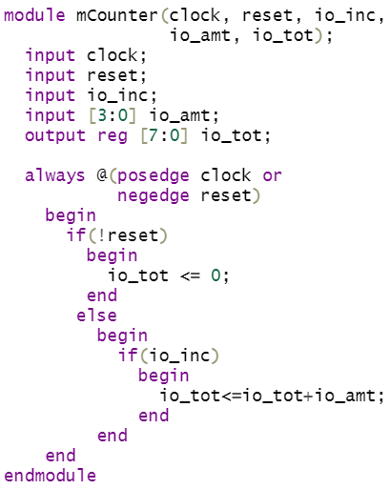
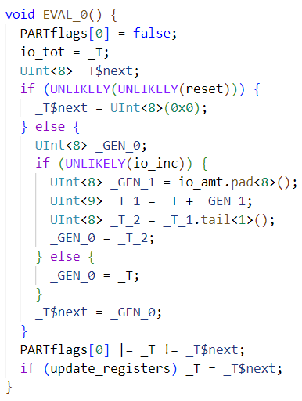
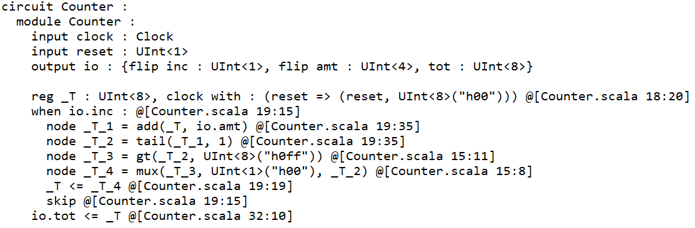
Example 1: Counter circuit
Figure 2: Circuit design
Figure 3: Chisel
Figure 4: Verilog
Essent
Figure 6: C-model
Figure 5: FIRRTL
ISPASS 2023 Tutorial

Slide 23
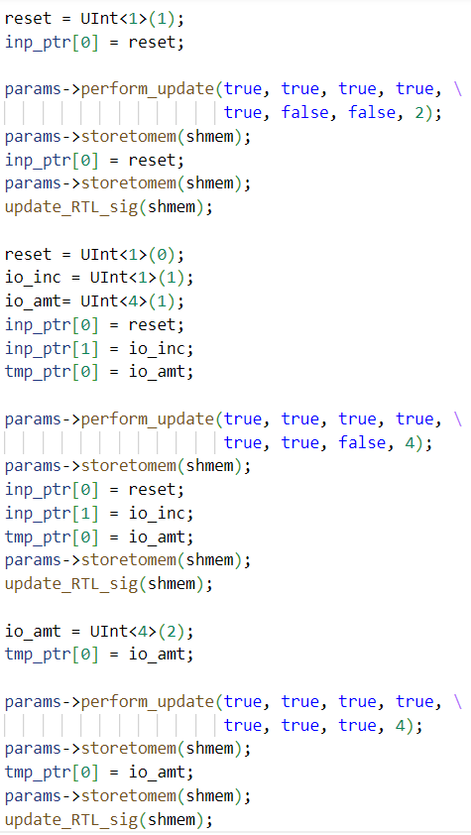
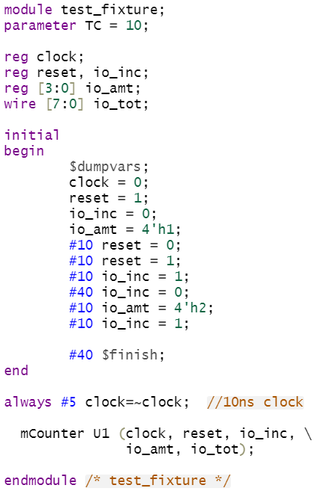
Example 1: Test bench in Verilog and SST
Rtlmodel-rtlaximodel-> Updated Rtl Params is: 1
Rtlmodel->sim cycles: 4
Rtlmodel->update inp: 1
Rtlmodel->update ctrl: 1
Rtlmodel->input sigs: 0x0<U1>Rtlmodel->input sigs: 0x1<U1>Rtlmodel->input sigs: 0x1<U4>
io tot: 0x00<U8>
io tot: 0x01<U8>
io tot: 0x02<U8>
Performing update on RTL params
Store to mem called
Store to mem finished
io tot: 0x03<U8>ArielComponent[arielcore.cc:1539:processNextEvent]
ArielRTLEvent is being issuedRtlmodel-rtlaximodel->
VecshiftReg RTL Event handle called
Rtlmodel-rtlaximodel->
Rtlmodel-rtlaximodel-> Updated Rtl Params is: 1
Rtlmodel->sim cycles: 4
Rtlmodel->update inp: 1
Rtlmodel->update ctrl: 1
Rtlmodel->input sigs: 0x0<U1>Rtlmodel->input sigs: 0x1<U1>Rtlmodel->input sigs: 0x2<U4>
io tot: 0x04<U8>
io tot: 0x06<U8>
io tot: 0x08<U8>
io tot: 0x0a<U8>Rtlmodel-rtlaximodel-> OKToEndSim, TickCount 4ArielComponent[arielcore.cc:1400:handleRtlAckEvent]
Ariel received Event from RTL. Generating Read Request
Figure 7: SST testbench
Figure 8: Verilog testbench
Figure 9: SST test log
Figure 10: Verilog test output
ISPASS 2023 Tutorial

Slide 24
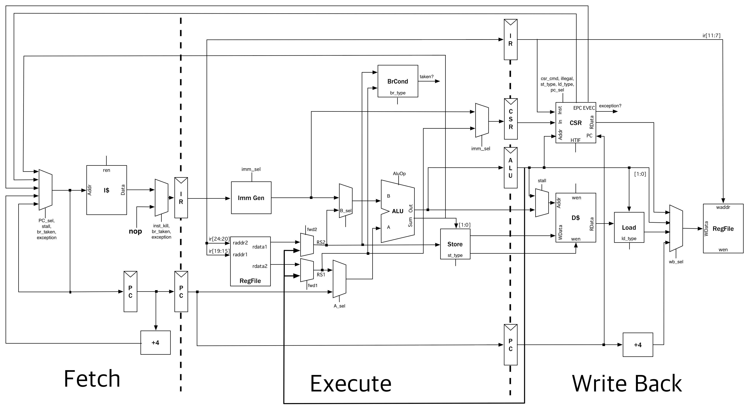
Example 2: Riscv-Mini & AXI handler
Riscv-Mini³ is a RISC-V 3-stage pipeline written in Chisel
The package comes with a simple inbuilt memory manager. It loads the binary to the memory which has a fixed access latency of 1 cycle
In this example, we replace the in-built memory manager with SST’s memhierarchy model
The Riscv-Mini CPU interfaces with memory manager using AXI4. However, SST’s memhierarchy model doesn’t have an inbuilt AXI interface
Figure 11: Riscv-Mini microarchitecture
3: https://github.com/ucb-bar/riscv-mini
ISPASS 2023 Tutorial

Slide 25
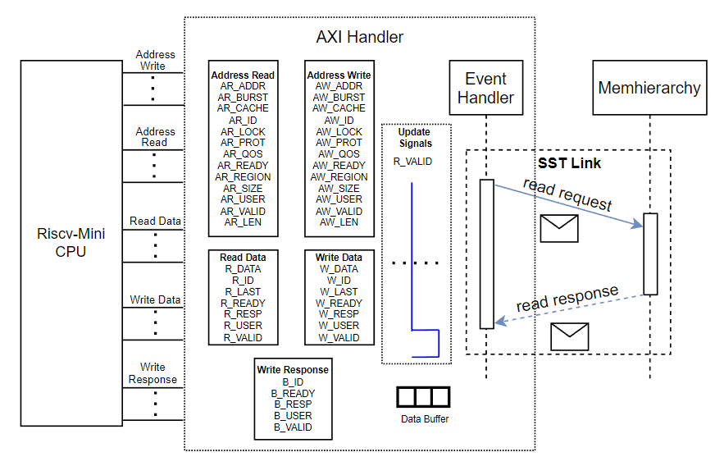
Example 2: Riscv-Mini & AXI handler (cont’d)
The AXI handler acts as a slave device which translates read/write requests received over AXI bus to SST events to read/write data from the memhierarchy.
The AXI handler synchronizes the updating of bus signals and communicating SST events.
A benchmark (quick sort) is loaded to memhierarchy and executed on the Riscv-Mini CPU to analyze the IPC for different L1 cache configurations
Figure 12: AXI Handler
ISPASS 2023 Tutorial

Slide 26
Design space exploration of L1 cache with Riscv-Mini CPU RTL
Config 1
cache size : 2 KB
cache type : inclusive
coherence protocol : MSI
replacement policy : lru
associativity : 2
access latency cycles : 1
cache line size : 64
Config 3
cache size : 64 KB
cache type : inclusive
coherence protocol : MSI
replacement policy : lru
associativity : 8
access latency cycles : 6
cache line size : 64
Config 2
cache size : 32 KB
cache type : inclusive
coherence protocol : MSI
replacement policy : lru
associativity : 4
access latency cycles : 4
cache line size : 64
Config 4
cache size : 128 KB
cache type : inclusive
coherence protocol : MSI
replacement policy : lru
associativity : 16
access latency cycles : 8
cache line size : 64
ISPASS 2023 Tutorial

Slide 27
Contributors
Sandia National Laboratories
C. Hughes, A. Rodrigues, G. Voskuilen, K. S. Hemmert, S. D. Hammond, B. Feinberg
Center for Computing Research
{chughes, afrodi, grvosku, kshemme, sdhammo, bfeinbe}@sandia.gov
North Carolina State University
S. K. Chunduru, S. Nema, M. Ambati, R. Razdan, J. Kirschner, D. Adak, H. Lee, A. Awad
Secure and Advanced Computer Architecture Lab
{schundu2, snema, mambati, rrazdan2, dadak, hyokeun_lee, jkirsch, ajawad}@ncsu.edu
ISPASS 2023 Tutorial

Slide 28
Thank You!
ISPASS 2023 Tutorial

Slide 29
Slide Left Blank

